Slide 1
Unit - iii
Production Analysis
Edited by
Parul
Notes:
<number>

Slide 2
Production function & technological change
A manager/economy is faced with the problem of ‘how to produce?’
He has to take a decision about the combination of fixed and variable factors should be employed
He has to decide about the input combination
S NEHRA EFE UNIT III 3.1
<number>
Notes:
<number>

Slide 3
Production and Production function
Production refers to the process by which man utilizes or converts the resources of nature, so as to satisfy human wants
Production function means transformation of physical inputs into outputs
Refers to the functional relationship between inputs & output under given technology
Mathematically, Q=f (f1,f2……….fn) Q= physical qty. of a certain product. f1,f2= various inputs needed to produce Q.
S NEHRA EFE UNIT III 3.1
<number>

Slide 4
S NEHRA EFE UNIT III 3.1
<number>

Slide 5
DEFINITIONS
“A production function refers to the functional relationship, under the given technology, between physical rates of input & output of a firm, per unit of time.”
“A production function relates maximum quantity of output that can be produced from given amount of various inputs for given technology.”
- McGuigan & Moyer.
S NEHRA EFE UNIT III 3.1
<number>

Slide 6
Factors affecting production function
Technology
Inputs – Land, labour, capital, entrepreneur
Inputs are divided into fixed and variable
Time period of production – Short run and long run
S NEHRA EFE UNIT III 3.1
<number>

Slide 7
Technological change
Technological change refers to a change in the underlying techniques of production, as occurs when a new product or process of production is invented or an old product or process is improved.
In such situations, the same output is produced with fewer inputs or more output is produced with the same inputs. Technological change shifts the production function upward.
Process innovation - occurs when new engineering knowledge improves production techniques for existing products
Product innovation - new or improved products are introduced in the market place
S NEHRA EFE UNIT III 3.1
<number>

Slide 8
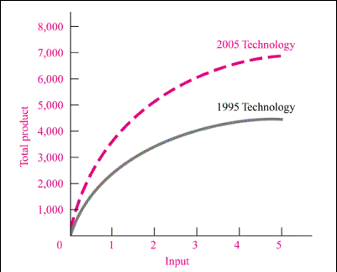
Technological Change Shifts Production Function Upward
S NEHRA EFE UNIT III 3.1
<number>
Notes:
<number>

Slide 9
short run & long run production functions
The inputs or factors of production are classified as fixed and variable.
Both short run & long run actually depends on the inputs, which can vary in production
Variable factors / inputs - can be changed in the short-run Ex- labour, electricity, fuel, transportation
Fixed factors / inputs - Cannot be changed during short-run Ex- land, capital, buildings, tools, machinery
S NEHRA EFE UNIT III 3.1
<number>

Slide 10
Production function with one fixed input & one variable input
We assume at least one input is fixed
Q = f(L, K) K is fixed here
OR
Q = f(K, L) L is fixed here
S NEHRA EFE UNIT III 3.1
<number>

Slide 11
3.2 law of diminishing marginal returns / law of variable proportion
The law basically explains the behaviour of production functions in the short run
“As the proportion of one factor in a combination of factors is increased after a point, the AVERAGE & MARGINAL production of that factor will diminish.”
When more units of variable factors used with the fixed factors a point is reached first MP falls, then the AP & finally the TP will diminish
This law is also called the law of variable proportions because it shows how output varies with variable and fixed inputs
S NEHRA EFE UNIT III 3.1
<number>

Slide 12
Concept of production
Total product -Total volume of goods & services produced
Average product - Per unit product of a variable product
Marginal product - Net addition to total product
S NEHRA EFE UNIT III 3.1
<number>

Slide 13
ASSUMPTIONS
Technology will remain constant
Quantity of at least one factor input is constant and one factor input is variable
Variable factors are homogeneous
The various factors are not to be used in rigidly fixed proportions but the law is based upon the possibility of varying proportions.
Addition to the variable input is made in equal increment
S NEHRA EFE UNIT III 3.1
<number>

Slide 14
Law of variable proportion schedule
No of workers | TP | AP | MP | Stage
1 | 2 | 2 | 2 | I stage
2 | 6 | 3 | 4
3 | 12 | 4 | 6
4 | 16 | 4 | 4
5 | 18 | 3.6 | 2 | II stage
6 | 18 | 3 | 0
7 | 14 | 2 | -4 | III stage
8 | 8 | 1 | -6
S NEHRA EFE UNIT III 3.1
<number>
Notes:
<number>

Slide 15
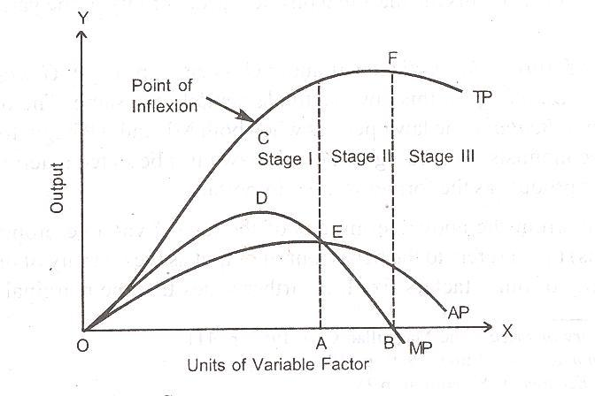
S NEHRA EFE UNIT III 3.1
<number>

Slide 16
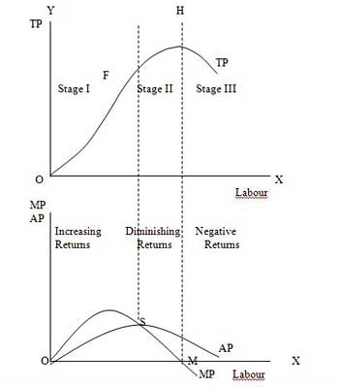
S NEHRA EFE UNIT III 3.1
<number>

Slide 17
Stages
Stage -1 (IRRATIONAL)
TP increases at an increasing rate
MP also rises
AP also increases but lies below MP
Indivisible fixed factors
Division of labour & specialization
Stage –II (RATIONAL)
TP rises but at a diminishing rate –Maximum
MP falls-Becomes zero
AP also diminish –AP>MP
Optimum utilization of resources.
S NEHRA EFE UNIT III 3.1
<number>

Slide 18
Stages contd…..
Stage-III (IRRATIONAL)
TP starts declining
MP becomes negative
AP also diminish
Excess variable factor with fixed factors
Universality of law-
Applies to every industry & firm
Operates in agriculture
Negative MP in PSU - SAIL
S NEHRA EFE UNIT III 3.1
<number>

Slide 19
Law of variable proportion and capacity planning
Total output decisions of a firm depend on the demand made by the consumers
Production decisions in turn influence the selection of the plant capacity in the short run
To operate in the second stage of increasing returns, the firm has to select the best combination of fixed inputs and variable inputs
Ex – Birla copper and rise in demand for furnaces for power
S NEHRA EFE UNIT III 3.1
<number>

Slide 20
Review question
Which of the following is most likely an example of production inputs that can be adjusted in the long run, but not in the short run?
Amount of wood used to make a desk.
Number of pickles put on a sandwich.
The size of a McDonald’s kitchen.
The amount of electricity consumed by a manufacturing plant.
S NEHRA EFE UNIT III 3.1
My Answer
b.
<number>
Notes:
<number>

Slide 21
Review question
The relationship between hours spent studying (input) and knowledge of economics (output) is positive. However, once you have done 20 hours of studying, an additional hour does not add as much to your knowledge as the first hour did. When you graph the relationship between studying and knowledge, is the resulting line straight or curved? Why?
S NEHRA EFE UNIT III 3.1
<number>

Slide 22
A shoe factory has 500 employees and produces a thousand pairs of shoes per hour.
The factory hires one new worker. Now, the factory produces 1,002 shoes per hour. Then the factory hires one more worker. Production rises to 1,004 per hour. Does the factory have diminishing, constant, or increasing marginal returns at this level of production?
S NEHRA EFE UNIT III 3.1
<number>

